Slide 1

Waterec
By
High Volunteers
Ulvi Yusifli ( ) Parviz Ramazanli Jamal Aslanov Askar Kolushev

Slide 2




Motivation of Project
Monitorising of water consumption
Reducing of human labor

Slide 3
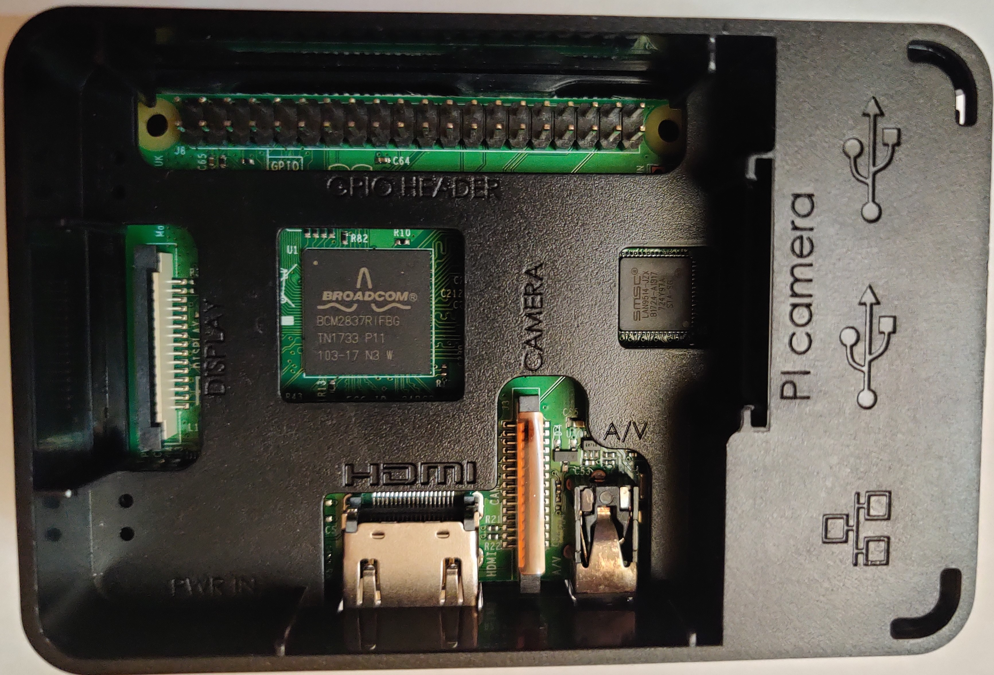
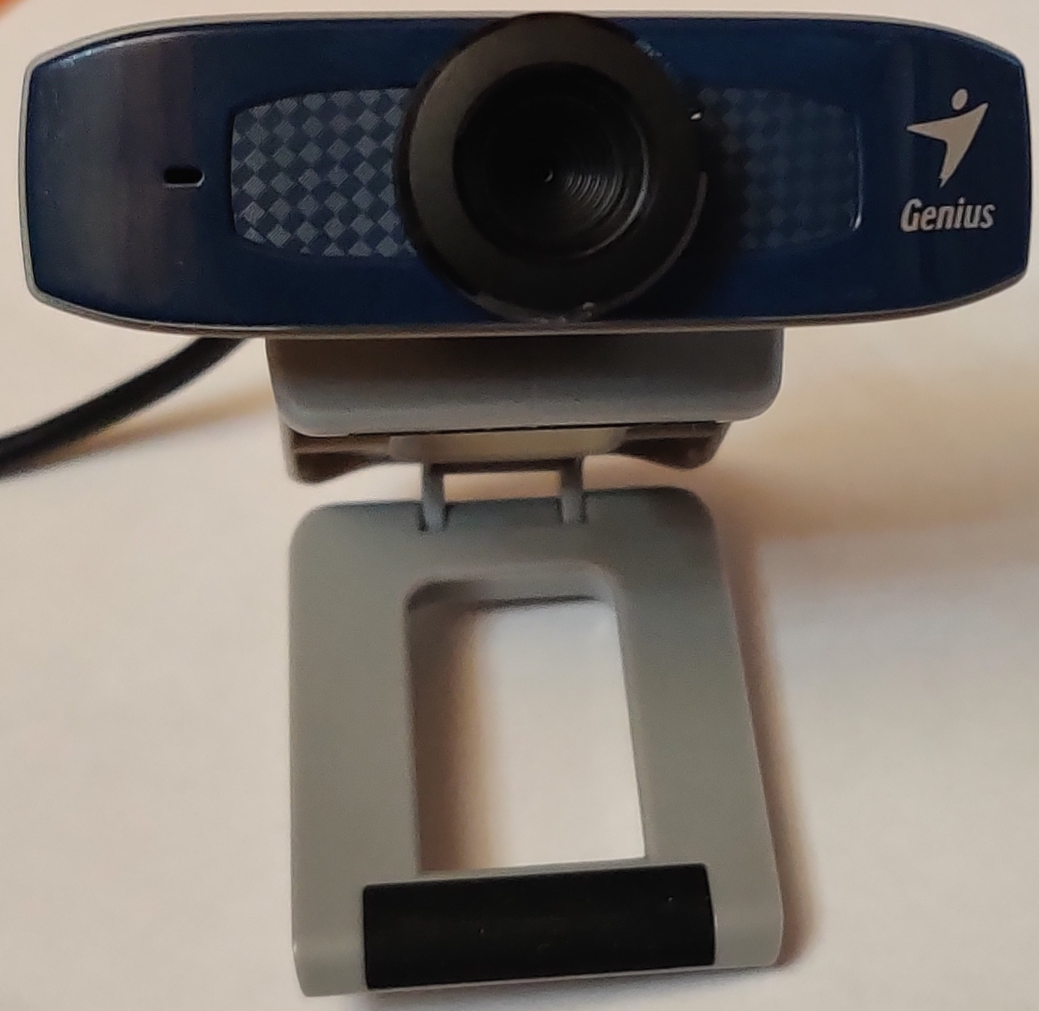
Applied Technologies for IoT
Raspberry Pi 3 Model B+
Genius FaceCam 320X
VGA WebCam
Programming language: Python 3
Optical character recognition: OCR.Space

Slide 4




Applied Technologies for Mobile App
Used programming language: Java (for Android application) & Python 3
Data storage: Azure SQL Database
Data storage access: Azure Functions (for safety)

Slide 5

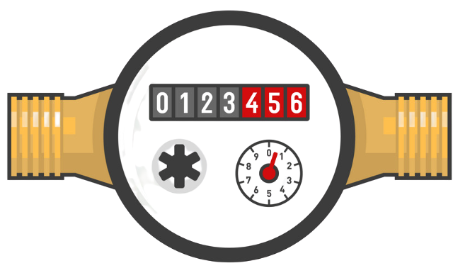
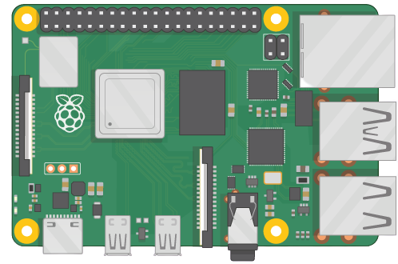

Design Diagram

Slide 6
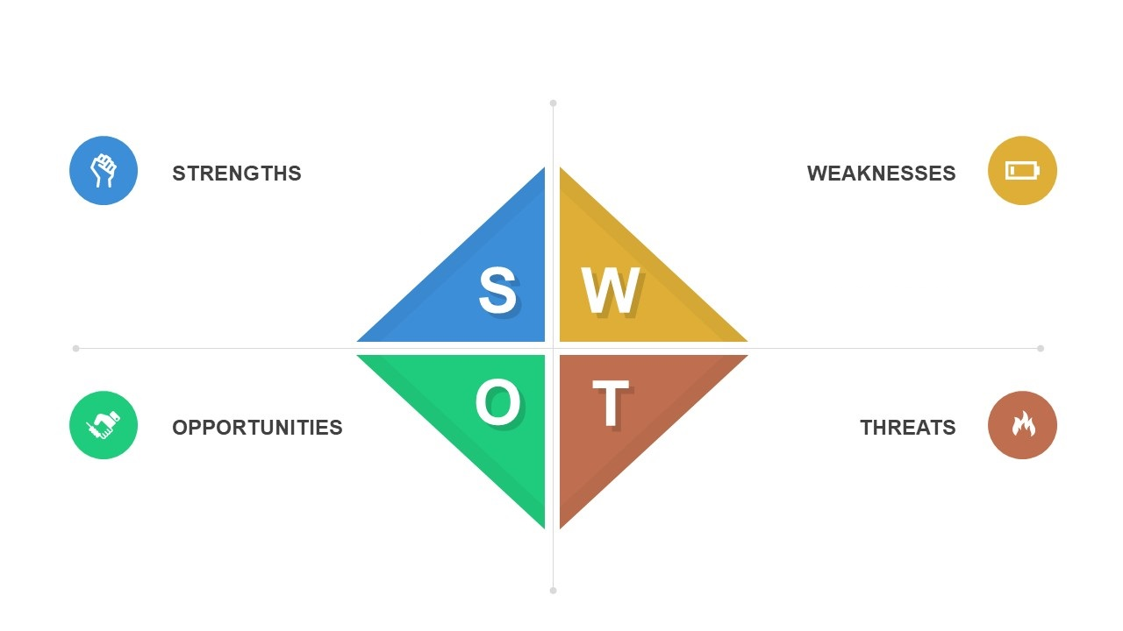
SWOT Analysis
Easy setups
Periodic data via mobile app
Water usage regulation
Error prone result
Time delays of data
Android based app
Free market & few competitors
Smart counter replacement
Integration to the technology
Installation cost

Slide 7


Market Analysis
Opponents: Pixometer, Anyline
Scanning via phone camera
Better OCR
Non-automation

Slide 8

Future work
Improvement of used technology
Creating & developing our OCR system
Increasing supported platforms
Mobile App development
Water limitation
Balance control
Improvement GUI

Slide 9


Thank you for attention!!!

